Slide 1
TwitterRank: finding topic-sensitive influential twitterers
Zhansaya Maksut

Slide 2
Paper Title | TwitterRank: finding topic-sensitive influential twitterers
Authors | Jianshu Weng, Ee-Peng Lim, Jing Jiang, Qi He
Affiliation | Pennsylvania State University, University Park, PA, USA Singapore Management University, Singapore, Singapore
Publication Journal | WSDM '10: Proceedings of the third ACM international conference on Web search and data mining
Publication Year | February 2010

Slide 3


Slide 4
Main problem
Benefits of Solving the Problem
Identify the influential twitterers
Brings order to the real-time web
Usage of Twitter as a marketing tool

Slide 5
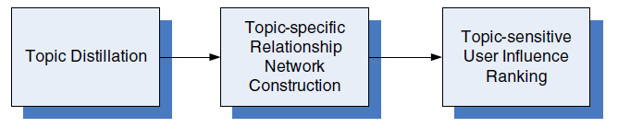
Proposed Solution
A new approach to measure the influence of twitterers - TwitterRank (extension of PageRank)
Figure 1. Framework of the Proposed Approach

Slide 6
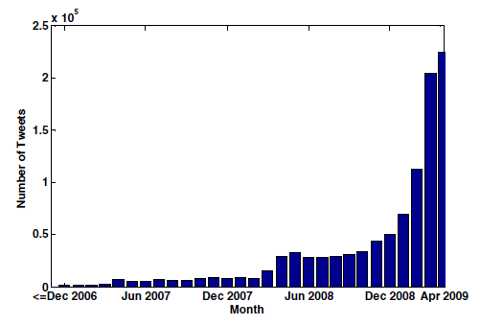
Dataset
A set of Twitter data about Singapore-based twitterers (April, 2009)
Figure 2. Number of Tweets per Month

Slide 7
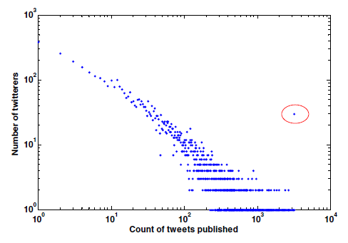
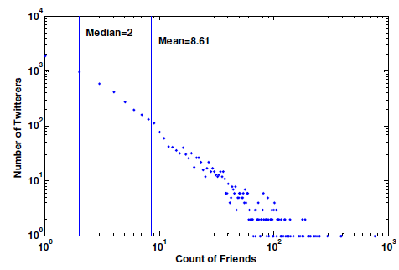
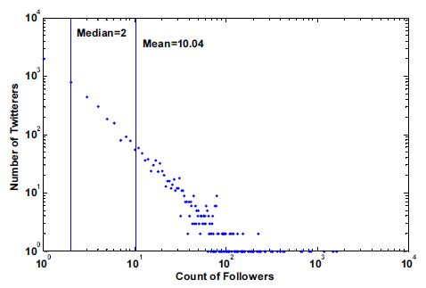
Figure 3. Distribution of tweets per Twitterer
Figure 5. Followers per Twitterer
Figure 4. Friends per Twitterer

Slide 8
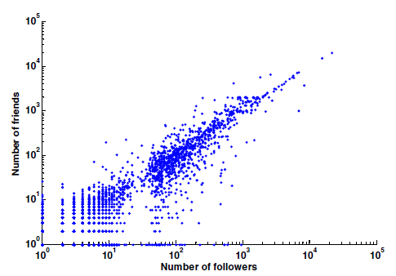
72.4% of the twitterers follow more than 80% of their followers
80.5% of the twitterers have 80% of their friends follow them back
Figure 6. Number of Friends vs. Number of Followers

Slide 9
Homophily
Homophily is a phenomenon showing that people’s social networks ‘are homogeneous with regard to many sociodemographic, behavioral, and intrapersonal characteristics’.

Slide 10
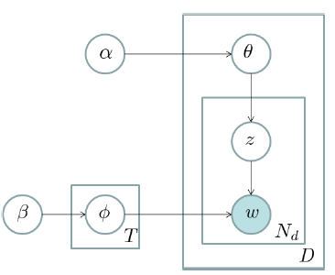
θ - multinomial distribution over T topics
φ - multinomial distribution over words
α, β - hyper-parameters
d - document
z - topic
w - word
Nd - total number of words in document d
Figure 7. Graphical Representation of LDA model

Slide 11


Topical difference between two twitterers s1 and s2
Topic specific TwitterRank of the twitterers in topic t

Slide 12
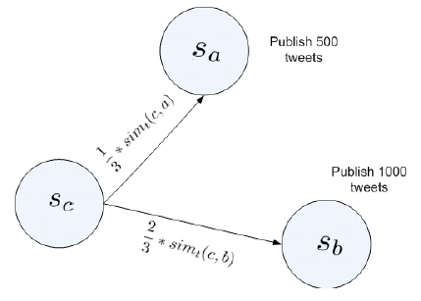
Figure 8. Example of Transition Probability Calculation

Slide 13
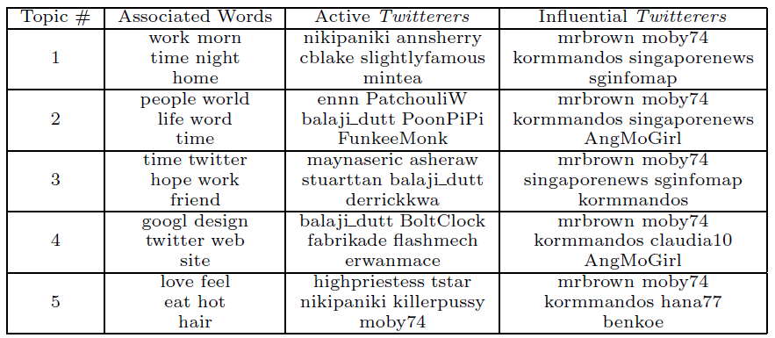
Table 1. Active and Influential Twitterers in Top Topics

Slide 14
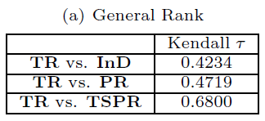
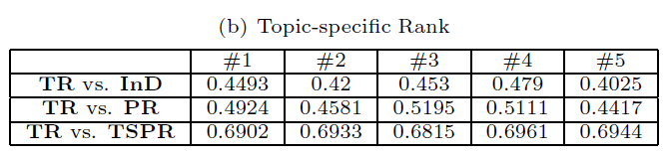
Evaluation
In-degree
PageRank
Topic-sensitive PageRank

Slide 15
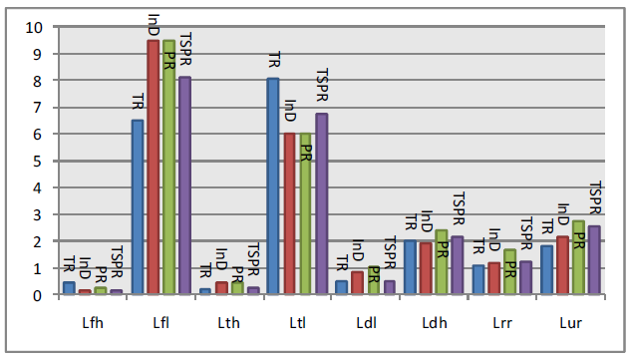
Figure 9. Comparison of Performance in the Recommendation Task

Slide 16
Main contributions
Reports homophily in Twitter
Introduces TwitterRank

Slide 17
SWOT analysis
Introducing a new metric, TwitterRank Contributing to the field of social media analysis and identifying influential users Reproducibilityof the approach | Limited evaluation (only on 2 datasets) Simplistic approach to ‘influence’ Limited measure of topical relevance
Can be applied to marketing, politics, journalism, etc. Can be extended to other social media platforms Refine the measures of influence and topical relevance | May not work effectively for all topics May not capture the complexity of information diffusion on Twitter Ethnical concerns may limit its practical application in real-world settings

Slide 18
References
Jianshu Weng, Ee-Peng Lim, Jing Jiang, and Qi He. 2010. TwitterRank: finding topic-sensitive influential twitterers. In Proceedings of the third ACM international conference on Web search and data mining (WSDM '10). Association for Computing Machinery, New York, NY, USA, 261–270. https://doi.org/10.1145/1718487.1718520

